Slide 2

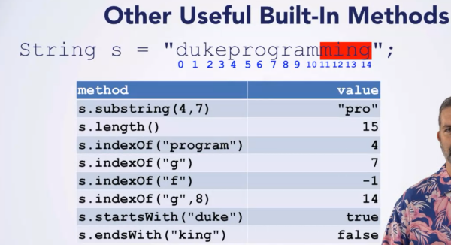
Positions in strings
Built-in method (no need create by yourself)

Slide 3
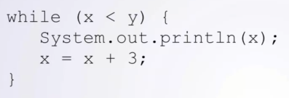
While loop

Slide 4
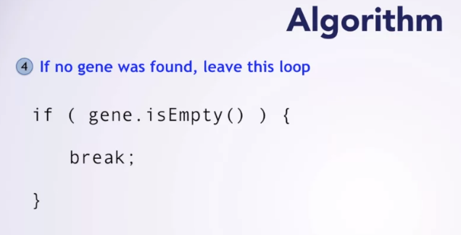
Break a loop

